Slide 1
Data science capstone
Lawrence Mak

Slide 2
Outline
Executive Summary
Introduction
Methodology
Results
Conclusion
Appendix

Slide 3
Executive summary
Summary of methodologies
- Data collection
- Data wrangling
- Exploratory Data Analysis with Data Visualization
- Exploratory Data Analysis with SQL
- Building an interactive map with Folium
- Building a Dashboard with Plotly Dash
- Predictive analysis (Classification)
Summary of all results
- Exploratory Data Analysis results
- Interactive analytics demo in screenshots
- Predictive analysis results

Slide 4
Introduction
Background and Context
Questions to be answered
SpaceX offers Falcon 9 rocket launches at a cost of $62 million, much lower than competitors due to their ability to reuse the first stage. Predicting the success of the first stage landing is crucial for estimating launch costs and competing bids. This project aims to create a machine learning pipeline for predicting successful first stage landings.
What variables affect a successful landing?
How does the interaction amongst these variables determine the success rate
What is the best algorithm for binary classification

Slide 5
Methodology
The overall methodology includes:
1. Data collection, wrangling, and formatting, using:
• SpaceX API
• Web scraping
2. Exploratory data analysis (EDA), using:
• Pandas and NumPy
• SQL
3. Data visualization, using:
• Matplotlib and Seaborn
• Folium
• Dash
4. Machine learning prediction, using
• Logistic regression
• Support vector machine (SVM)
• Decision tree
• K-nearest neighbors (KNN)

Slide 6
Data Collection – Spacex api
Request rocket launch data from SpaceXAPI
Decode the response content using.json() and turning it into a dataframe using .json_normalize()
Request needed information about the launches from SpaceXAPI by applying custom functions
Construct obtained data into a dictionary
5. Create a dataframe from the dictionary
6. Filter the data frame to only include Falcon 9 launches
7. Replace missing values of Payload Mass column with calculated.mean() for this column
8. Export the data to CSV
GITHUB

Slide 7
Data Collection – Web scraping
Request Falcon 9 launch data from Wikipedia
Create a BeautifulSoup object from the HTML response
Extract all column names from the HTML table header
Collect the data by parsing HTML tables
5. Construct data obtained data into a dictionary
6. Create a dataframe from the dictionary
7. Export the data to CSV
GITHUB

Slide 8
Data wrangling
Data Wrangling:
The data is processed to handle missing entries and encode categorical features using one-hot encoding.
An additional column named 'Class' is introduced to the dataframe, where:
'Class' contains 0 if a launch is failed and 1 if it is successful.
The resulting dataset comprises 90 rows (instances) and 83 columns (features).
In the dataset, various scenarios depict the outcome of booster landings:
True Ocean: Successful landing in a specific region of the ocean.
False Ocean: Unsuccessful landing in a specific region of the ocean.
True RTLS: Successful landing on a ground pad.
False RTLS: Unsuccessful landing on a ground pad.
True ASDS: Successful landing on a drone ship.
False ASDS: Unsuccessful landing on a drone ship.
These outcomes are primarily transformed into Training Labels:
"1" indicates a successful booster landing.
"0" indicates an unsuccessful landing.

Slide 9
Eda with pandas and numpy
Charts were plotted to visualize various relationships:
Flight Number vs. Payload Mass
Flight Number vs. Launch Site
Payload Mass vs. Launch Site
Orbit Type vs. Success Rate
Flight Number vs. Orbit Type
Payload Mass vs. Orbit Type
Success Rate Yearly Trend
Scatterplots illustrate the relationship between variables, which could be utilized in a machine learning model if a relationship exists.
Bar charts provide comparisons among discrete categories, aiming to demonstrate the relationship between specific categories and a measured value.
Line charts depict trends in data over time (time series).

Slide 10
Eda with sql
Displayed the names of the unique launch sites in the space mission
Displayed 5 records where launch sites begin with the string 'CCA'
Displayed the total payload mass carried by boosters launched by NASA (CRS)
Displayed average payload mass carried by booster version F9v1.1
Listed the date when the first successful landing outcome in ground pad was achieved
Listed the names of the boosters which have success in droneship and have payload mass greater than 4000 but less than 6000
Listed the total number of successful and failure mission outcomes
Listed the names of the booster versions which have carried the maximum payload mass
Listed the failed landing outcomes in droneship, their booster versions, and launch site names for the months in year 2015
Ranked the count of landing outcomes (such as failure (droneship) or success (groundpad)) between the date 2010-06-04 and 2017-03-20 in descending order

Slide 11
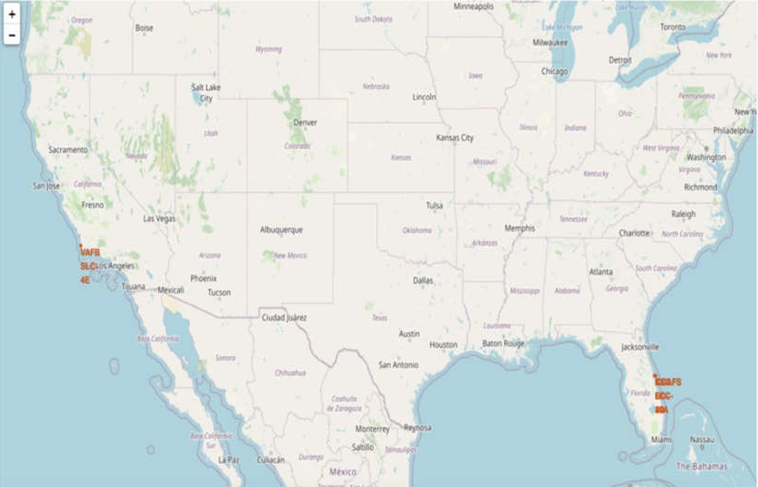
Interactive map with folium
All launch sites on a map
All launch sites were marked, and map objects like markers, circles, and lines were added to indicate launch success or failure for each site on the folium map.
Launch outcomes (failure or success) were assigned to class 0 and 1, with 0 denoting failure and 1 denoting success.
Utilizing color-labeled marker clusters, launch sites with relatively high success rates were identified.
Distances between launch sites and nearby features were calculated to address questions such as:
Proximity to railways, highways, and coastlines.
Distance maintained from cities.

Slide 12
Building a dashboard with plotly
Launch Sites Dropdown List:
A dropdown list has been added to enable selection of launch sites.
Pie Chart Showing Success Launches (All Sites/Certain Site):
A pie chart has been included to display the total count of successful launches for all sites and the success versus failed counts for the selected site, if a specific launch site was chosen.
Slider of Payload Mass Range:
A slider has been implemented to select the payload range.
Scatter Chart of Payload Mass vs. Success Rate for the Different Booster Versions:
A scatter chart has been added to illustrate the correlation between payload and launch success for various booster versions.

Slide 13

Predictive analysis (Classification)
The data was loaded using numpy and pandas, transformed, and split into training and testing sets.
Various machine learning models were constructed, and different hyperparameters were tuned using GridSearchCV.
Accuracy served as the metric for the model, which was enhanced through feature engineering and algorithm tuning.
The best-performing classification model was identified.
Decision Tree:
GridSearchCV best score: 0.8892857142857142 Accuracy score on test set: 0.8333333333333334

Slide 14
Section 2: insights drawn from eda visualization

Slide 15
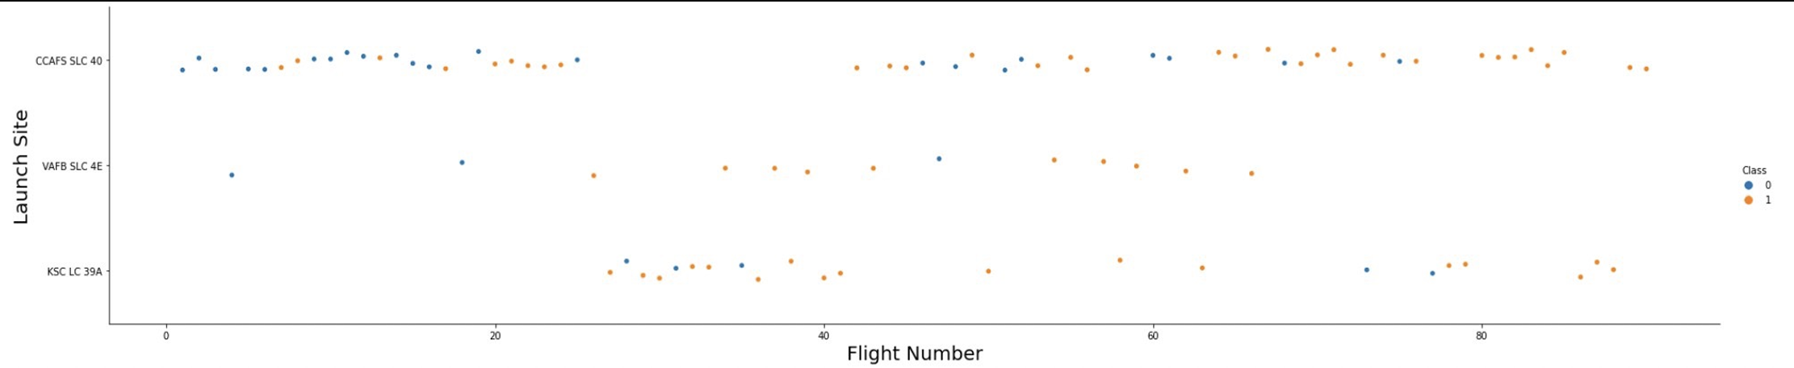
Flight number vs. Launch site
Initial flights experienced failures, whereas recent flights achieved success.
Approximately half of all launches occur at the CCAFS SLC-40 launch site.
VAFB SLC-4E and KSC LC-39A demonstrate higher success rates.
It is reasonable to expect that each new launch exhibits a higher success rate.

Slide 16
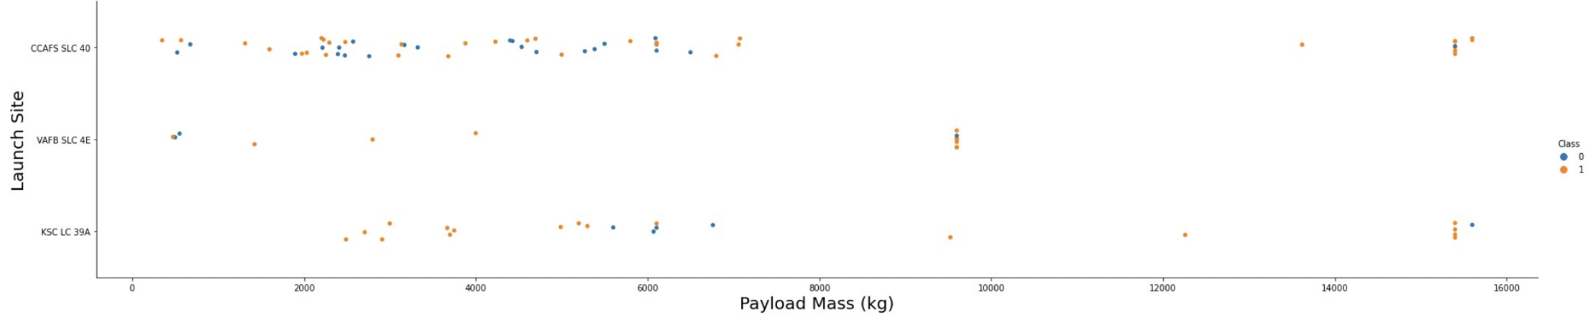
Payload vs. Launch site
For each launch site, success rates increase with higher payload mass.
The majority of launches with payload mass over 7000kg resulted in success.
KSC LC-39A achieved a 100% success rate for payload mass under 5500kg as well.

Slide 17
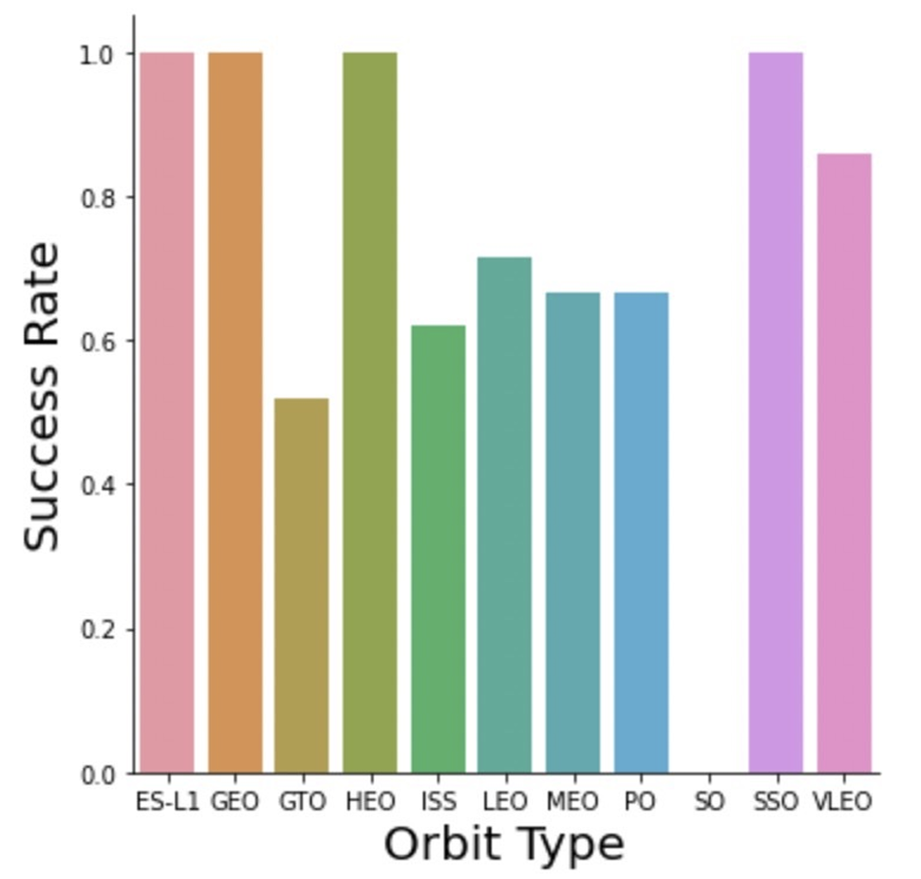
Success rate vs. orbit type
From the plot, we can see that ES-L1, GEO, HEO, SSO, VLEO had the highest success rate.

Slide 18
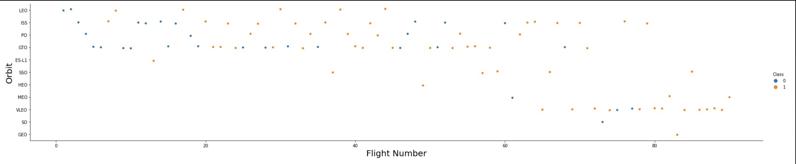
Flight number vs. Orbit type
The diagram illustrates the relationship between Flight Number and Orbit type. It is evident that in the LEO orbit, success tends to correlate with the number of flights. However, in the GTO orbit, there is no discernible relationship between flight number and orbit.

Slide 19
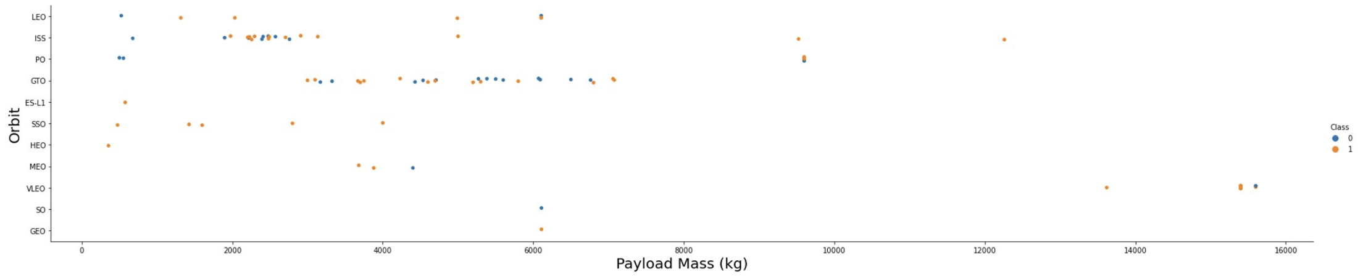
payload mass vs. Orbit type
Heavy payloads exert a negative influence on GTO orbits but have a positive impact on GTO and Polar LEO (ISS) orbits.

Slide 20
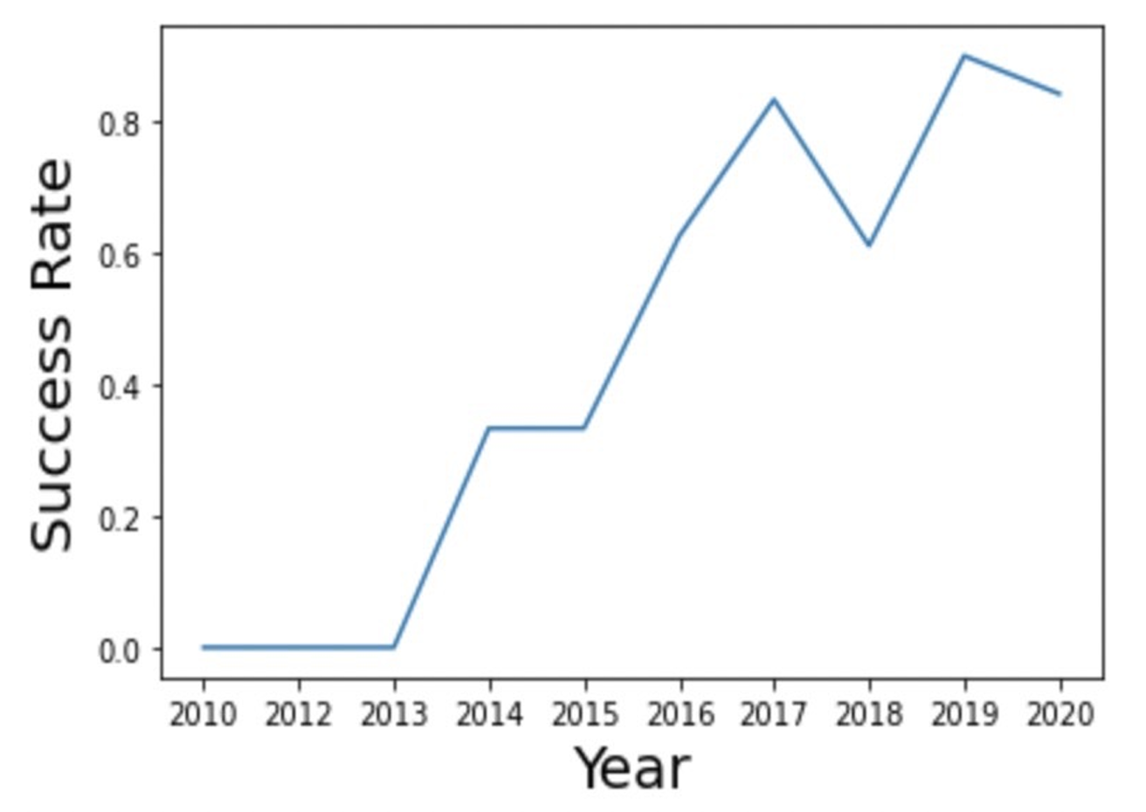
Launch success yearly trend
The success rate rises overtime as more improvements on the technology are made

Slide 21
Section 3: insights drawn from eda sql

Slide 22
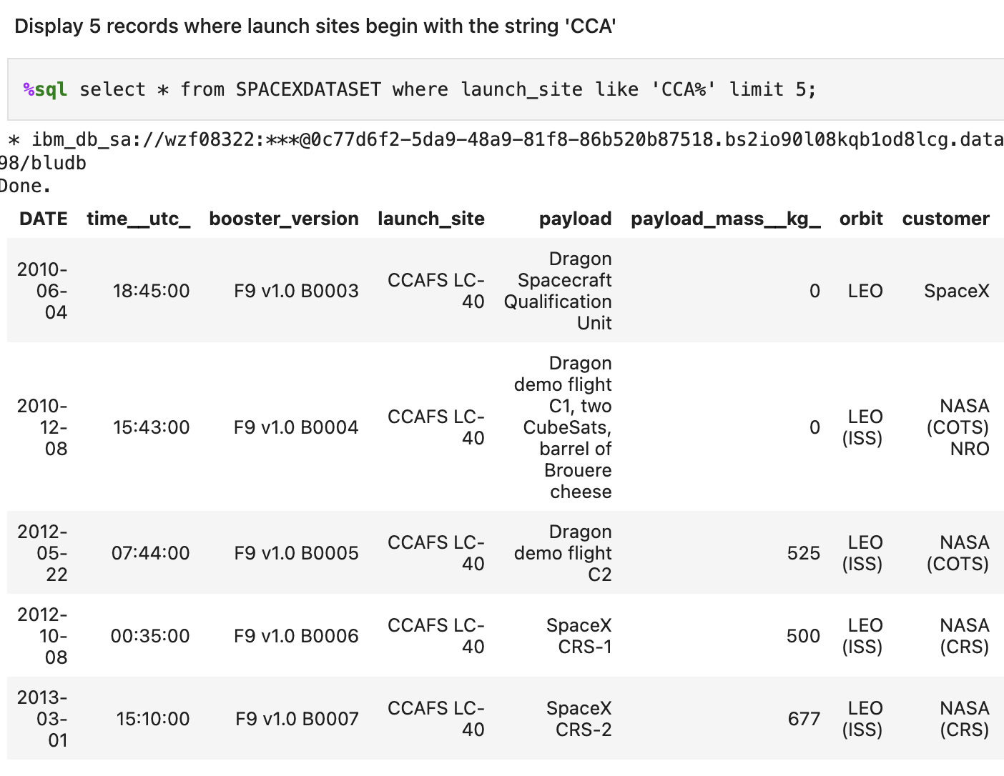
Launch site names that begin with 'cca'
Use the query to display 5 records where the launch site names begins with 'CCA'
GITHUB

Slide 23
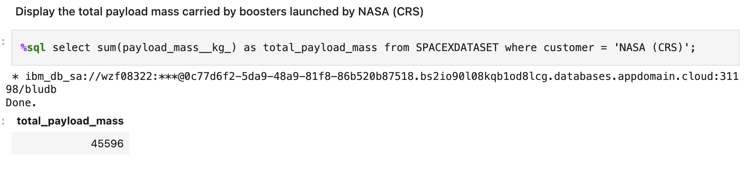
Total payload mass
Use the query to display total payload mass by boosters launched by NASA
GITHUB

Slide 24
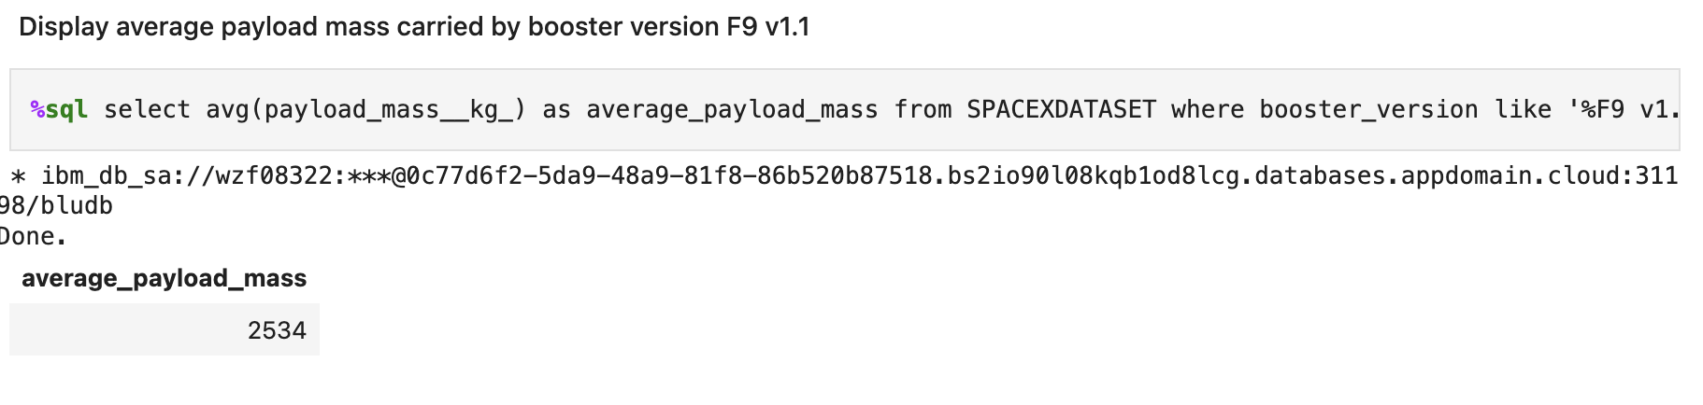
Average payload mass by f9 v1.1
Use the query to display average payload mass by Booster version F9 V1.1
GITHUB

Slide 25
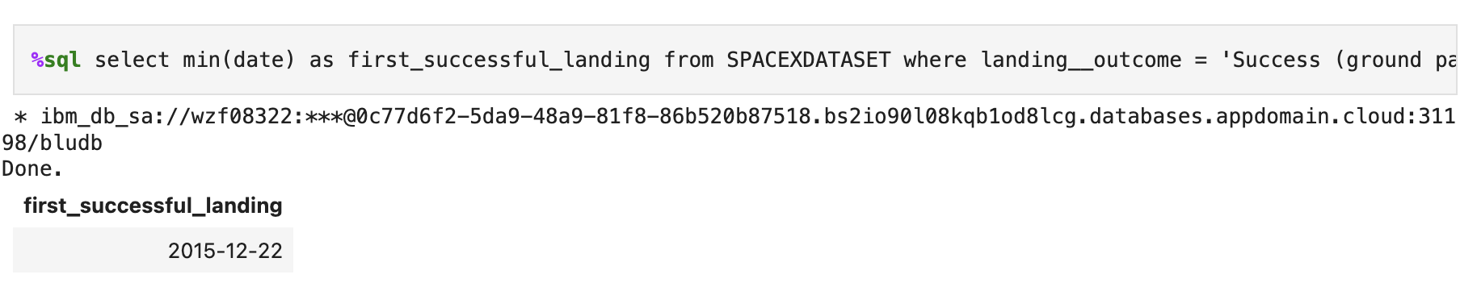
First successful ground landing date
Use the query to display the first successful ground landing date
GITHUB

Slide 26
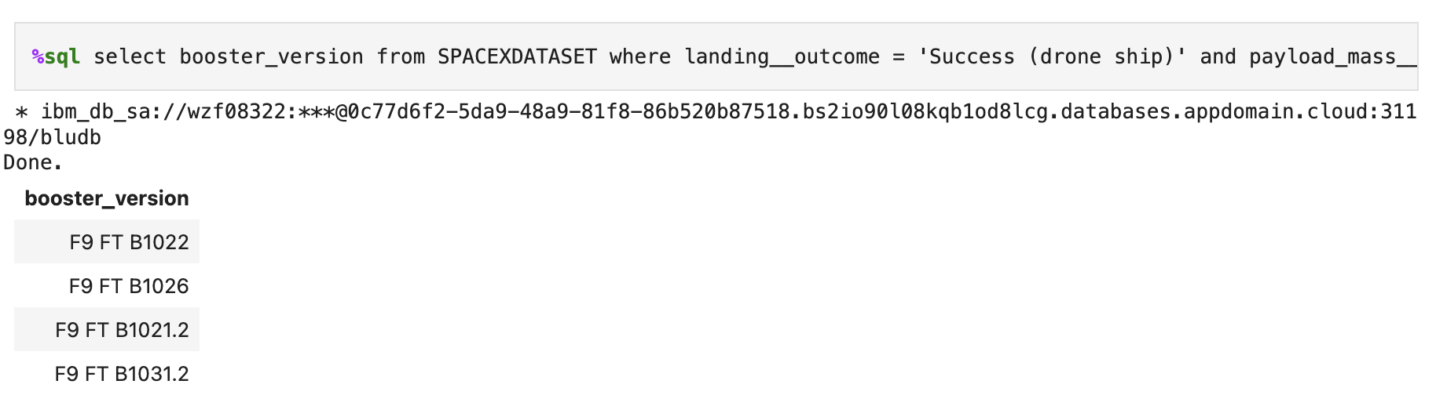
Successful Drone Ship Landing with Payload between 4000 and 6000
Use the query to display the names of boosters that had a successful landing with a payload mass between 4000 and 6000
GITHUB

Slide 27
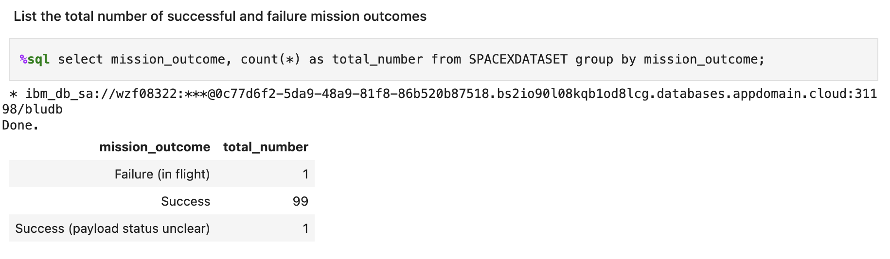
Total number of successful and failure mission outcomes
Use the query to display the amount of successful and non-successful missions
GITHUB

Slide 28
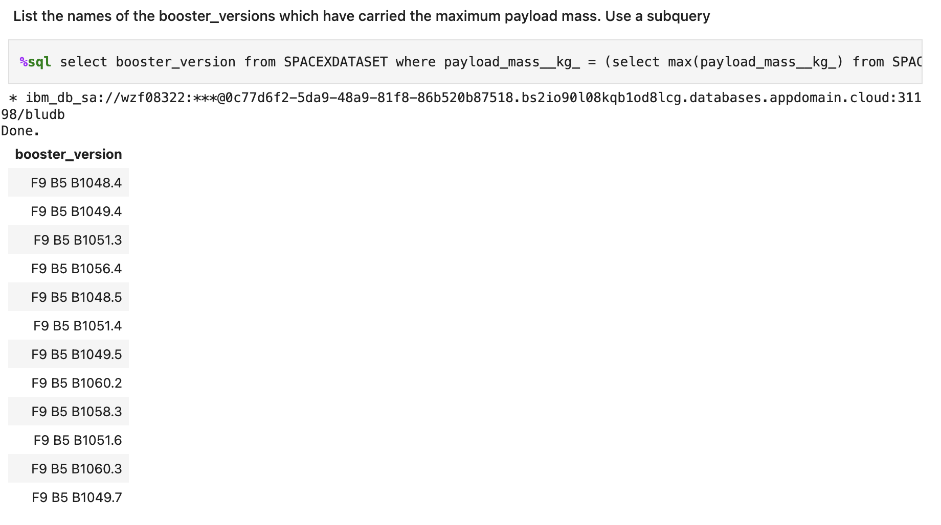
Boosters carried maximum payload
Use the query to display the names of boosters which have successfully carried the maximum payload
GITHUB

Slide 29
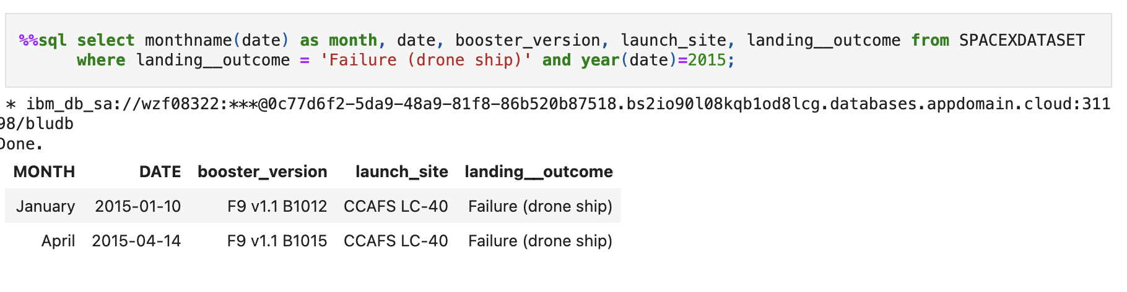
2015 launch records
Use the query to display a list of the failed landings in drone ship, their booster versions, and launch site names for the year 2015
GITHUB

Slide 30
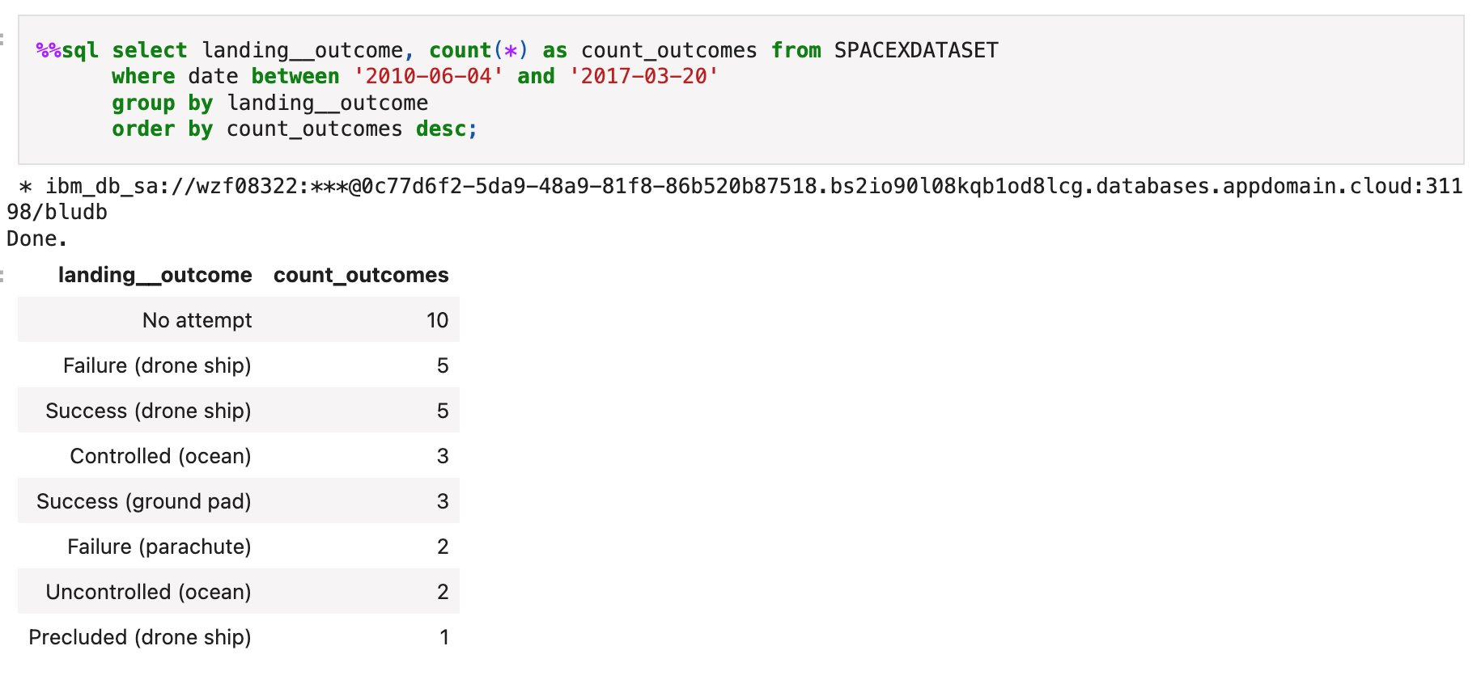
Rank Success count between 2010-06-04 and 2017-03-20
Landing outcomes and the count of landing outcomes were selected from the data, and the WHERE clause was utilized to filter for landing outcomes between June 4, 2010, and March 20, 2010.
The GROUP BY clause was applied to group the landing outcomes, and the ORDER BY clause was used to arrange the grouped landing outcome in descending order.
GITHUB

Slide 31
Section 4: interactive map with folium

Slide 32
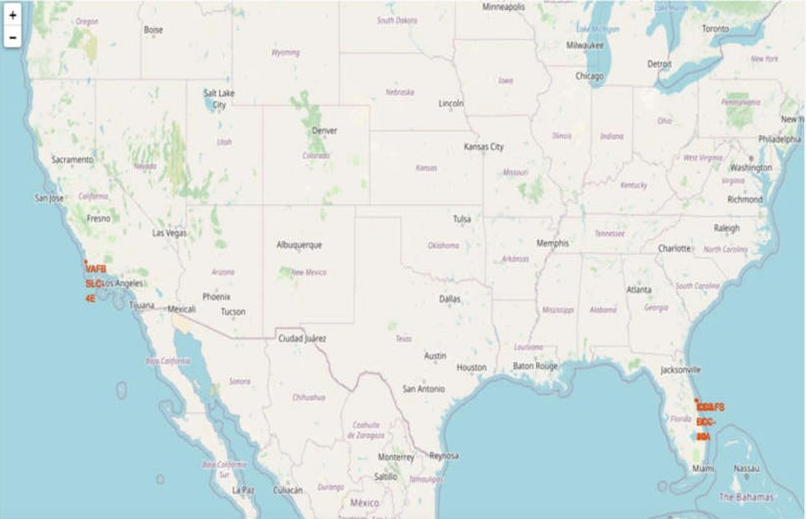
All launch site locations on a global map
Most launch sites are situated in proximity to the Equator line. This location is advantageous because the land moves faster at the equator than at any other point on the Earth's surface, with a speed of approximately 1670 km/hour. When a spacecraft is launched from the equator, it inherits this velocity, aiding it in achieving and maintaining orbit due to inertia.
Additionally, all launch sites are positioned very close to the coast. Launching rockets towards the ocean minimizes the risk of debris falling or exploding near populated areas.

Slide 33
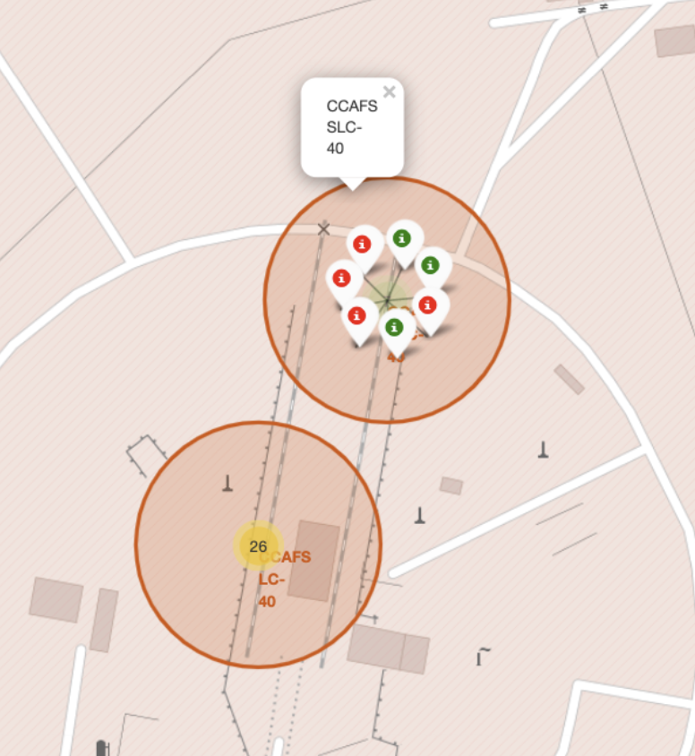
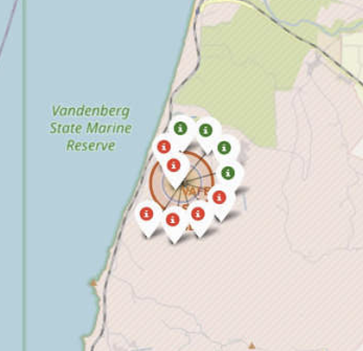
Color labelled launch records on the map
successful and failed launch sites
From the color-labeled markers, we can readily identify launch sites with relatively high success rates:
Green Marker = Successful Launch
Red Marker = Failed Launch Launch Site KSC LC-39A exhibits a very high success rate.

Slide 34
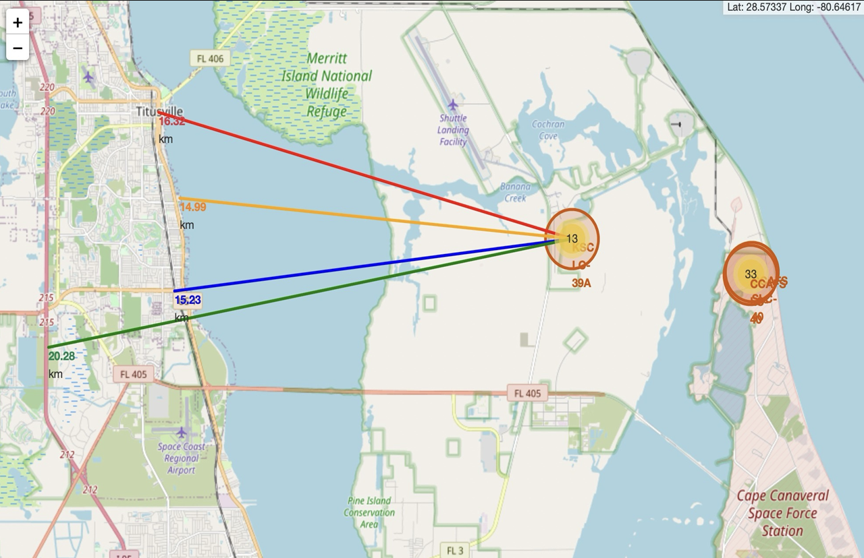
The distance between ksc lc-39a to its proximities
Visual analysis of launch site KSC LC-39A reveals its proximity to various landmarks:
It is relatively close to a railway, approximately 15.23 km away.
It is also near a highway, about 20.28 km away.
The coastline is nearby, with a distance of approximately 14.99 km.
Additionally, the launch site is relatively close to its nearest city, Titusville, at a distance of around 16.32 km.
Considering the high speed of a failed rocket, which can cover distances of 15-20 km in just a few seconds, there is potential danger to populated areas in the vicinity.

Slide 35
Section 5: building a dashboard with plotly

Slide 36
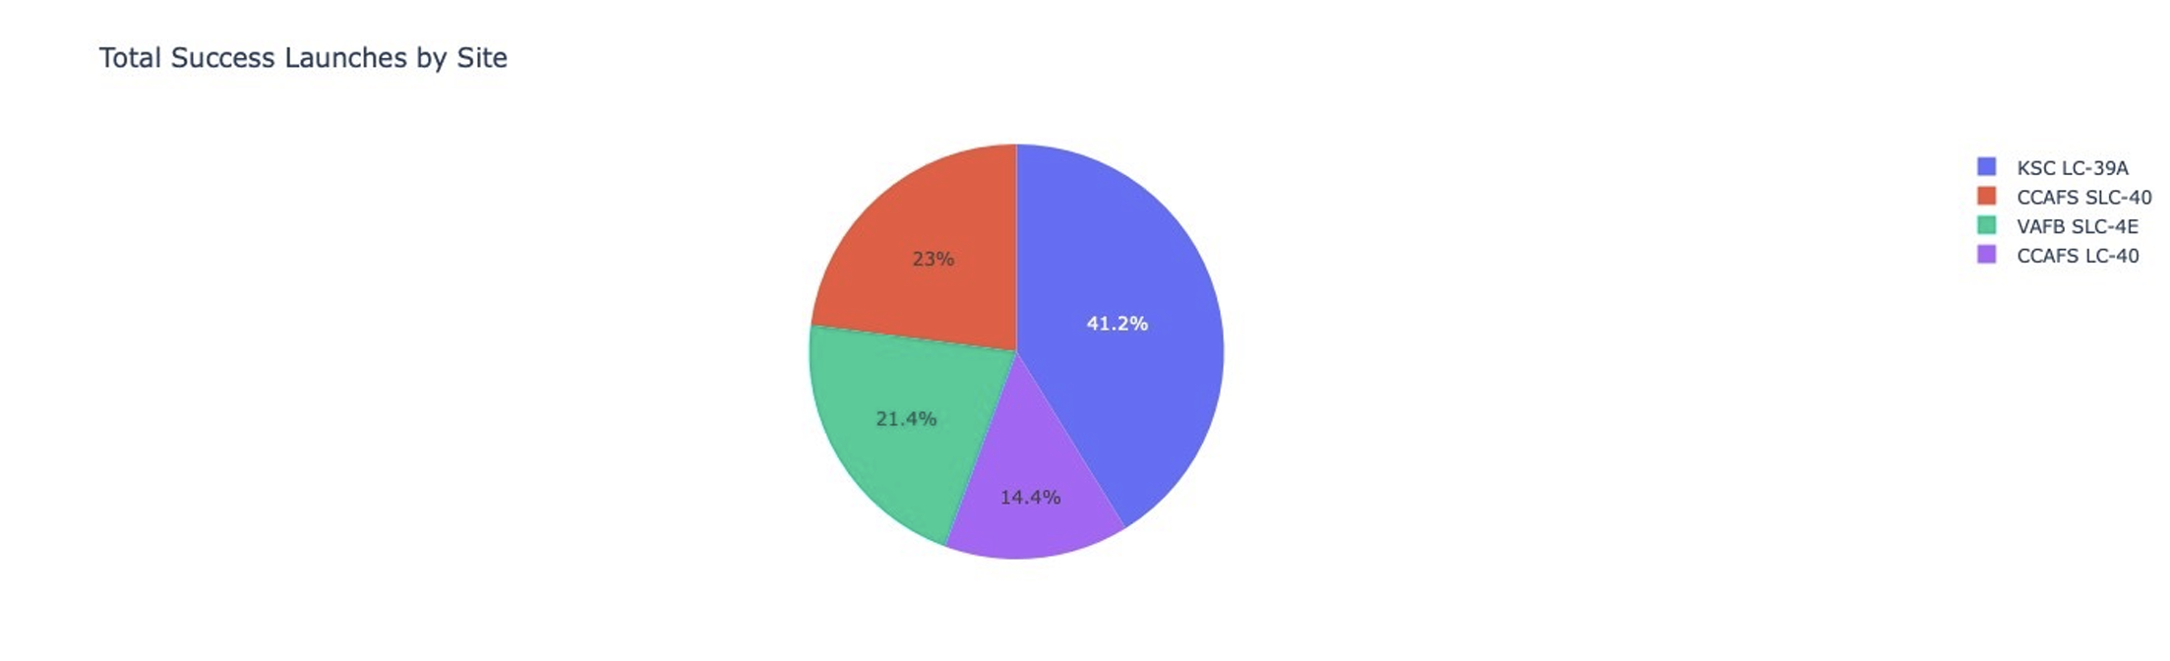
Launch success by site
The diagram shows that from all sites, KSC LC-39A has the most successful launches

Slide 37
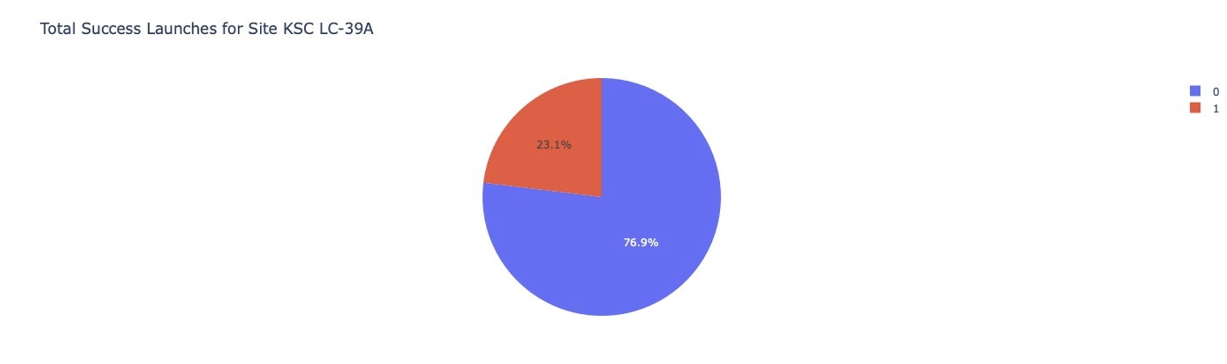
Launch site with highest success ratio
The diagram shows that KSC LC-39A has the highest successful landing ratio, standing at 10:3

Slide 38
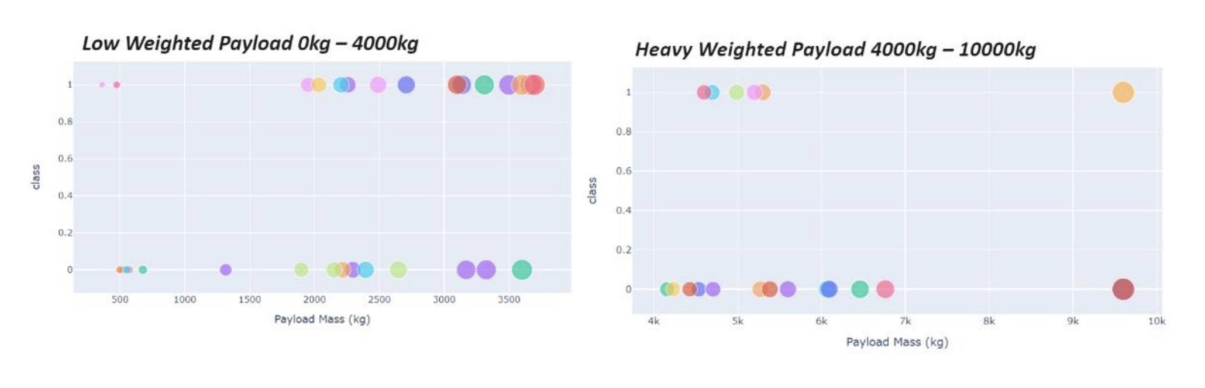
Payload mass vs launch outcomes for all sites
The diagram shows that payloads between 2000 and 5500kg have the highest success rate

Slide 39
Section 6: predictive analysis (classification)

Slide 40
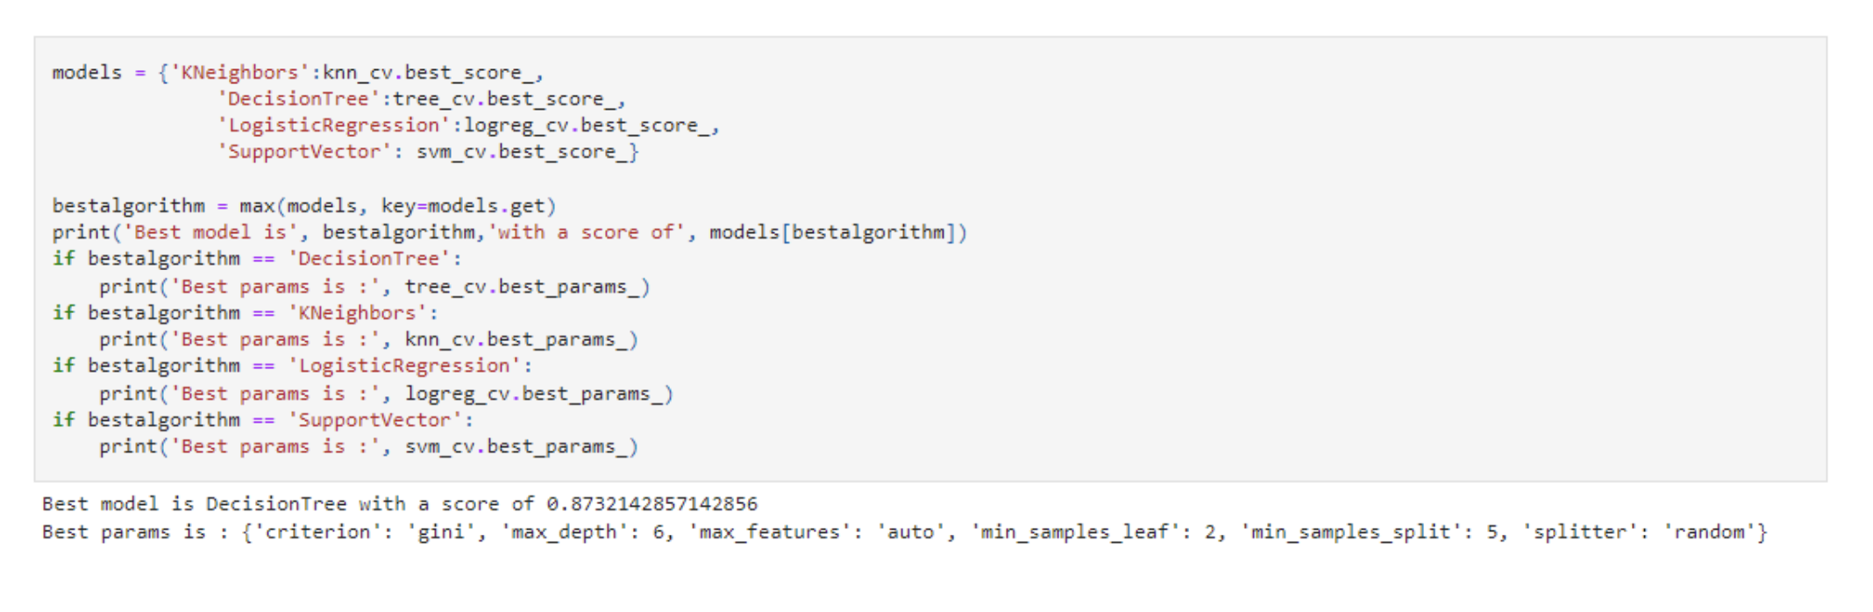
Classification accuracy
The decision tree classifier is the model with the highest classification accuracy

Slide 41

Confusion matrix
The confusion matrix for the decision tree classifier indicates that the classifier is capable of distinguishing between different classes. However, the primary issue lies in false positives, where unsuccessful landings are incorrectly identified as successful landings by the classifier.

Slide 42
Conclusions
The Decision Tree Model is identified as the best algorithm for this dataset.
Launches with lower payload masses exhibit better results compared to launches with larger payload masses.
Most launch sites are situated in proximity to the Equator line, and all sites are very close to the coast.
The success rate of launches demonstrates an increasing trend over the years.
Launch site KSCLC-39A boasts the highest success rate among all sites.
The larger the number of flights at a launch site, the higher the success rate.
Launch success rate began to rise in 2013 and continued until 2020.
Orbits ES-L1, GEO, HEO, SSO, and VLEO exhibit the highest success rates.
KSC LC-39A registers the highest number of successful launches among all sites.

Slide 43
THANK YOU
Lawrence Mak
647-884-7651
maklawrence1110@gmail.com

